Slide 1
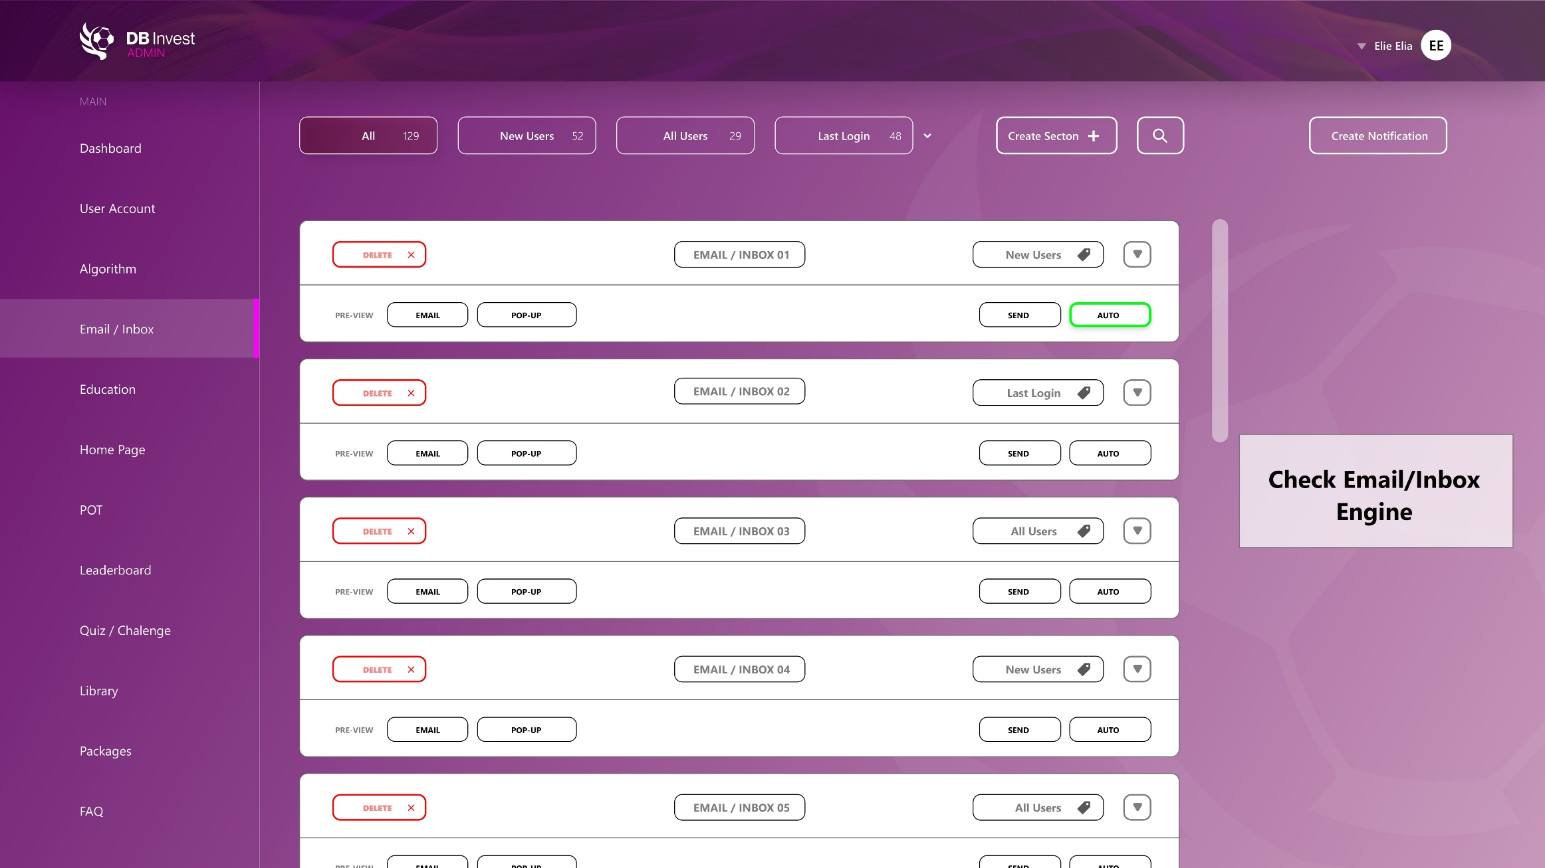
Email-inbox (how it should have been)

Slide 2
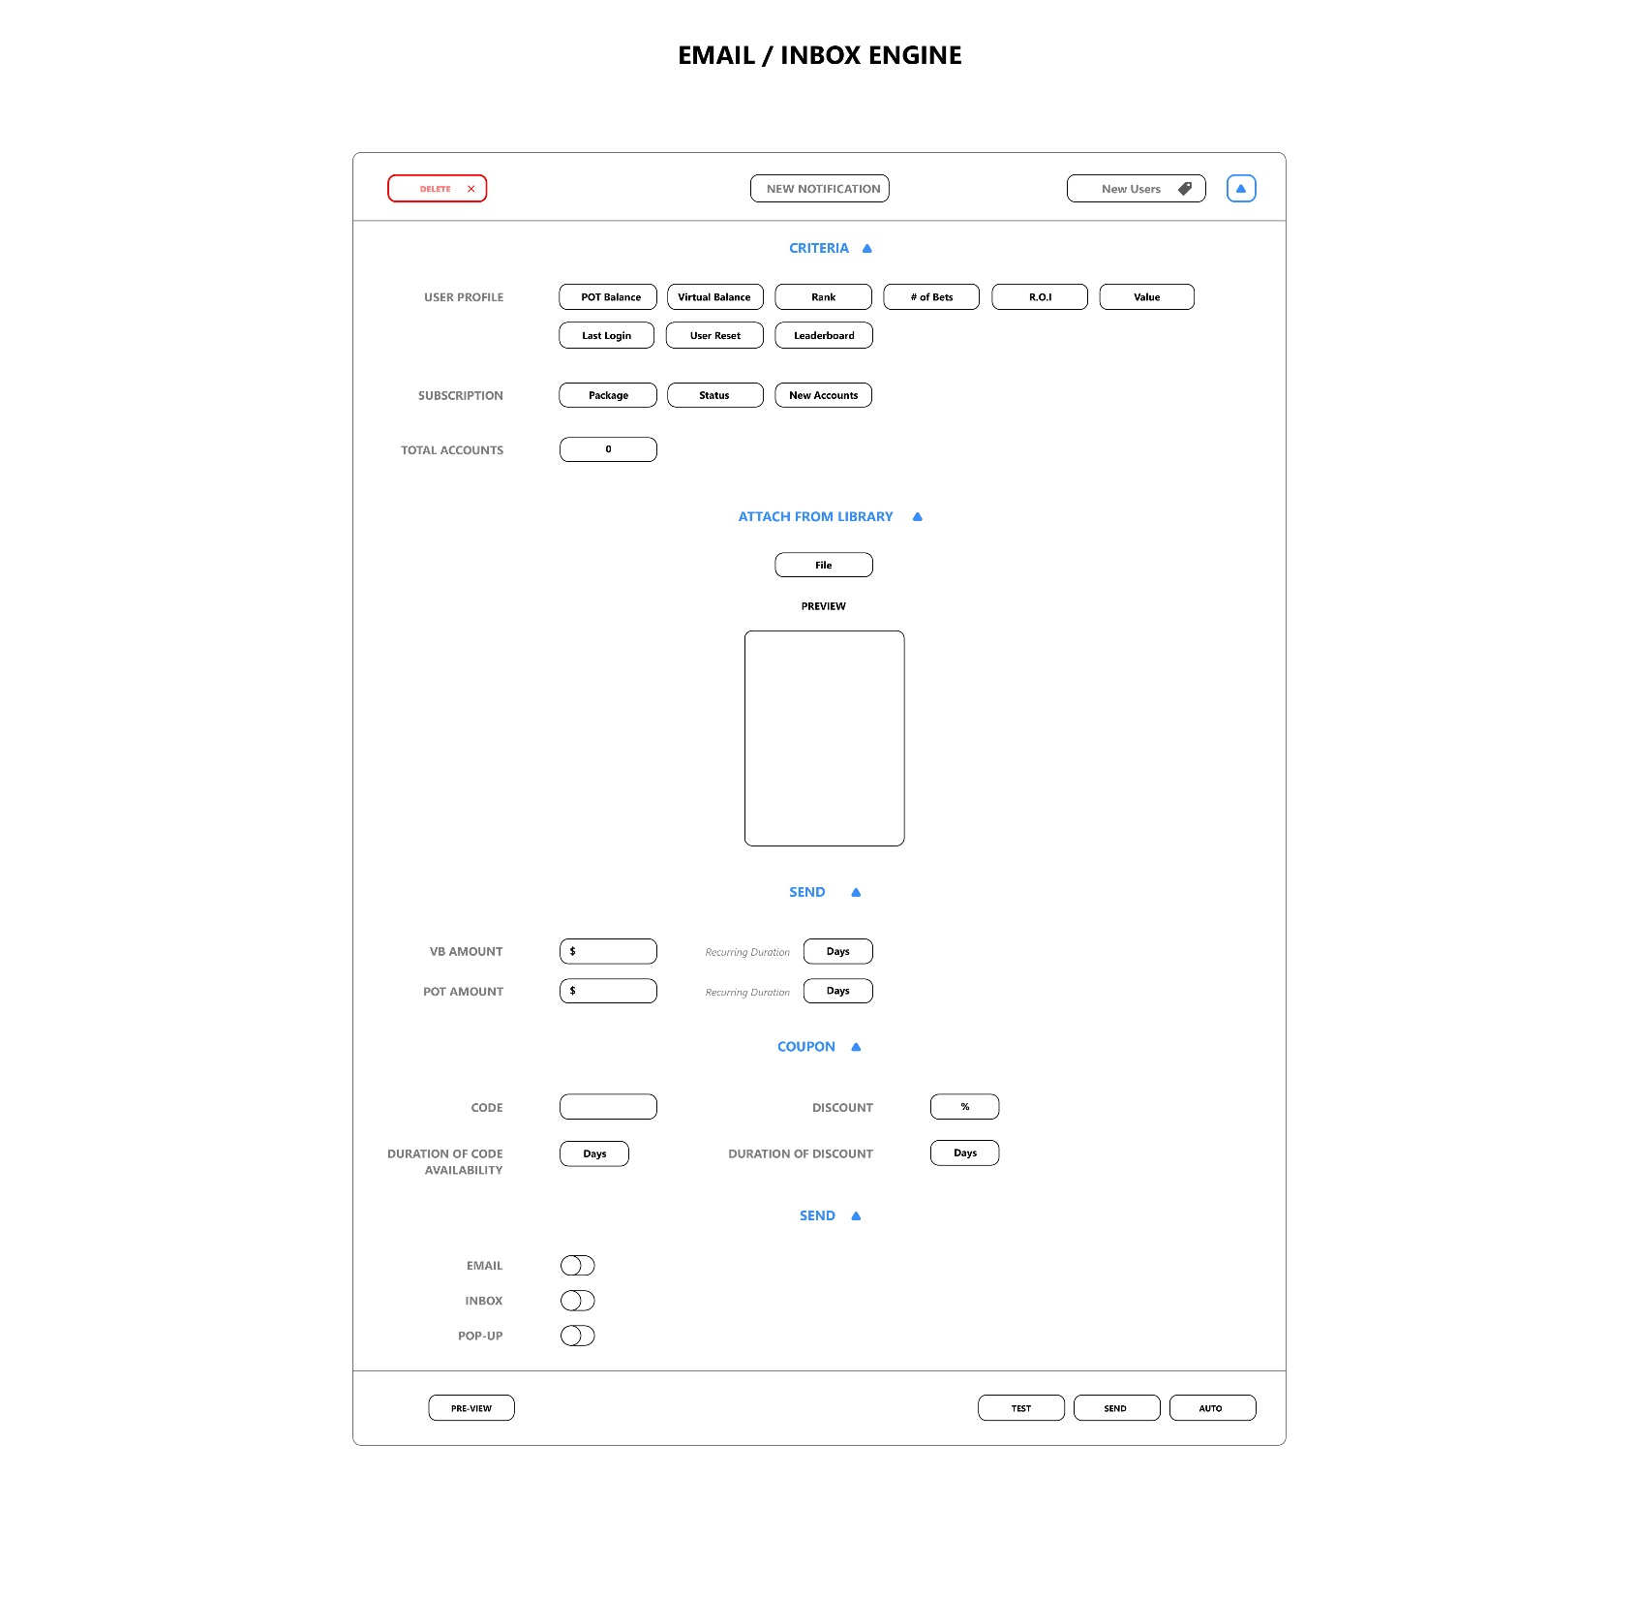

Slide 3
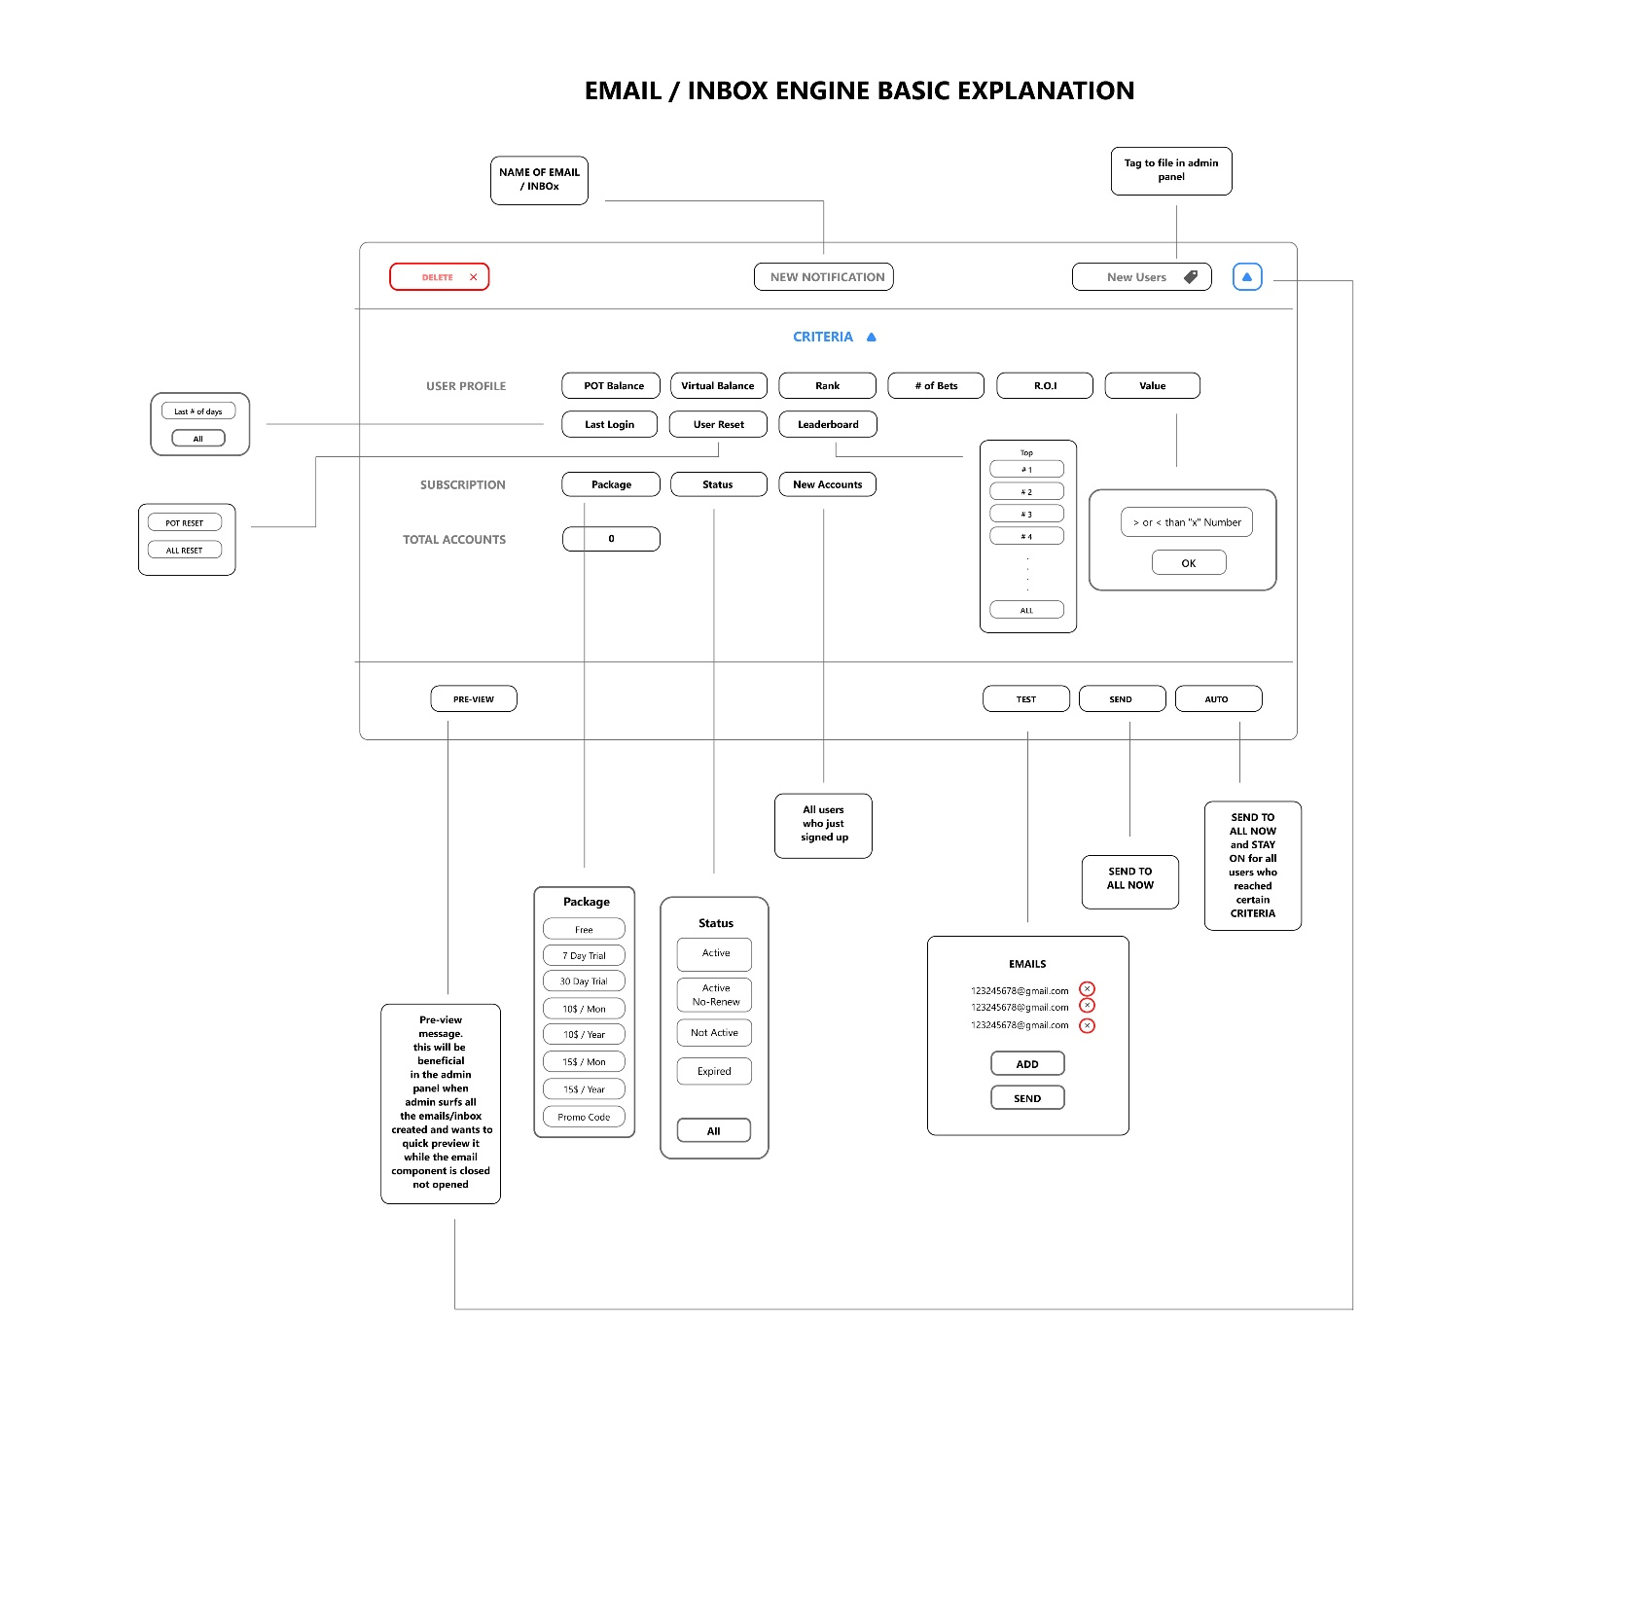

Slide 4
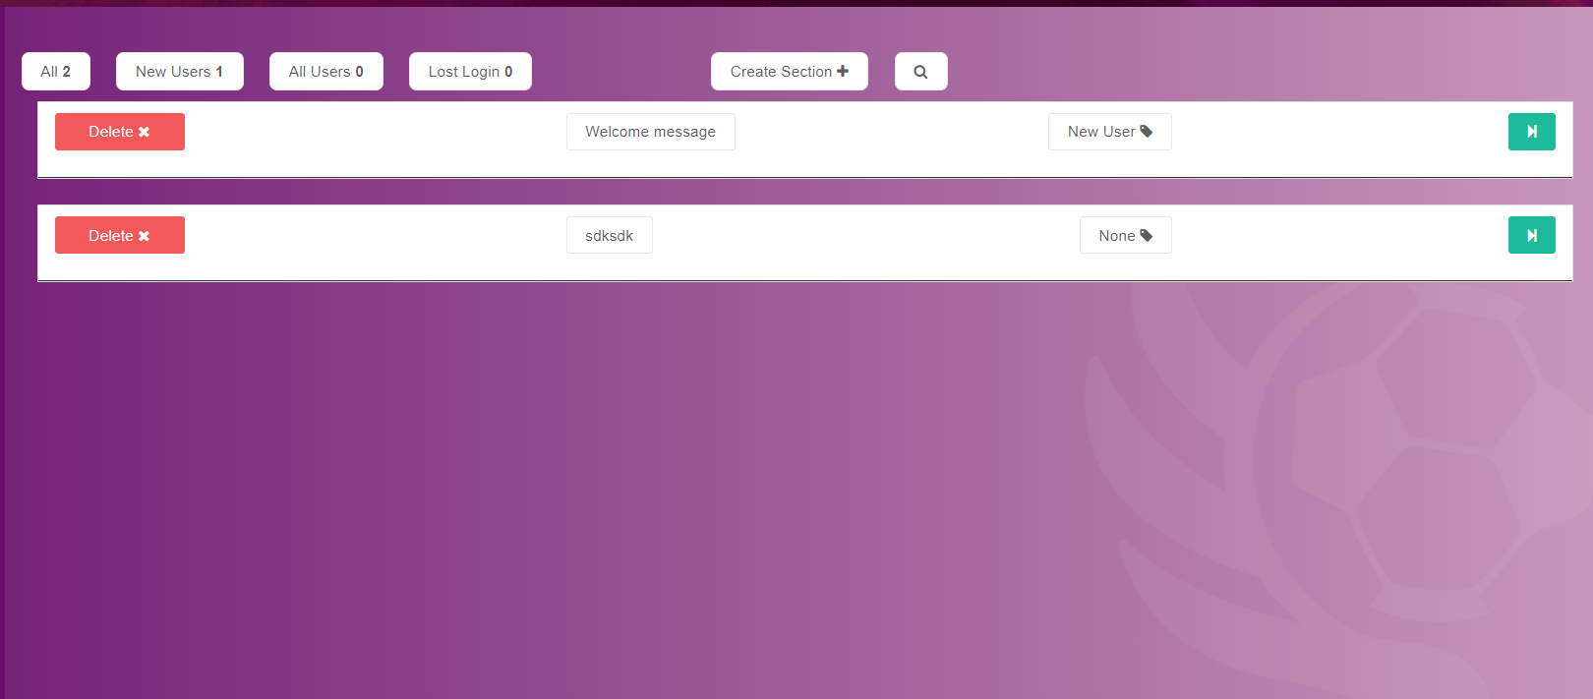
Vs how it is now

Slide 5
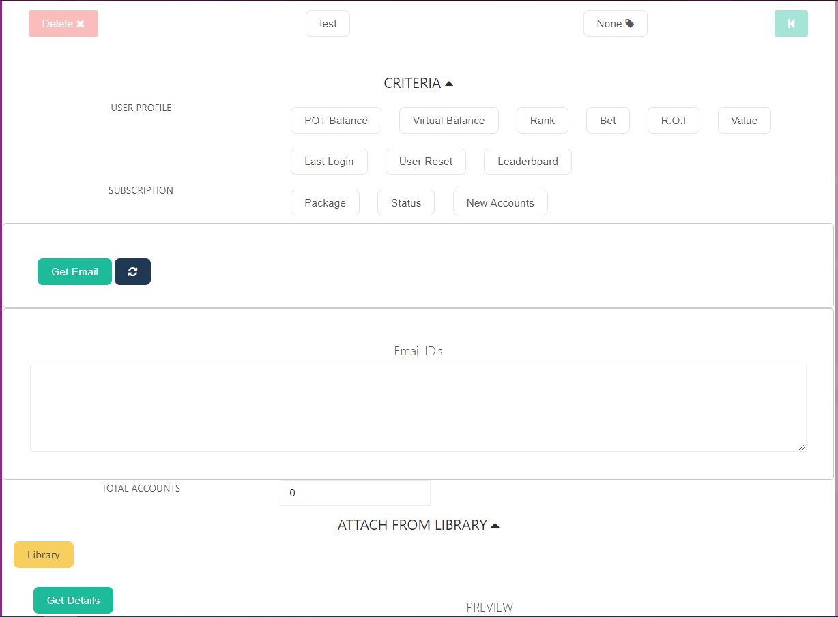

Slide 6
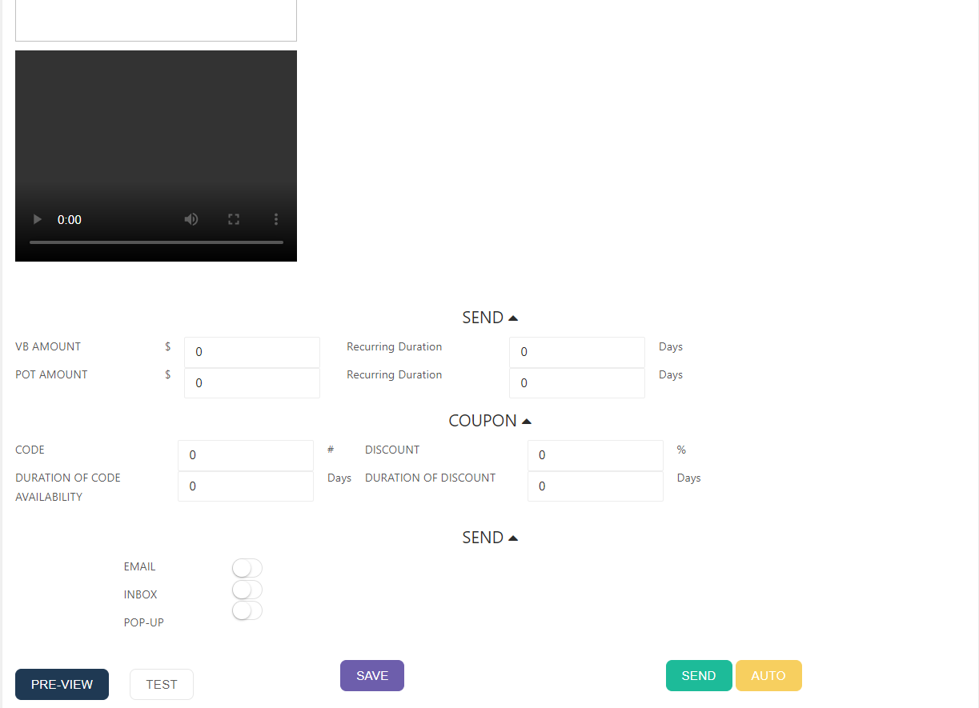

Slide 7
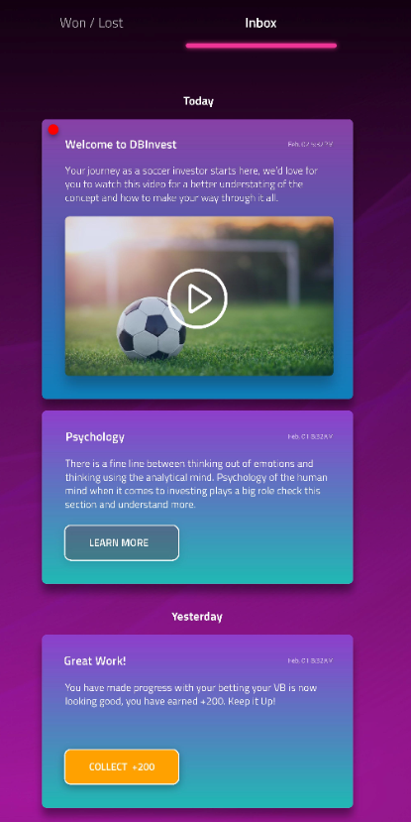
How it should work:
Admins can send messages/emails to users.
These messages can either be a message to inbox, or a pop up on the screen, or an email. Basically there are 3 types of messages admin can send:
Title, text with image
Title, text with YouTube video URL
Title, text with virtual balance to collect

Slide 8
Where we are now:
Right now, we can send these 3 type of emails, but they are not stable… sometimes there’s a limit of how much the text can be, sometimes it just doesn’t work, and sometimes the video doesn’t load.
Plus, we should be able to set auto send email function for certain criteria, like if a user signs up he get a welcome message, or if a user ranks up he gets a congratulations…

